Slide 1
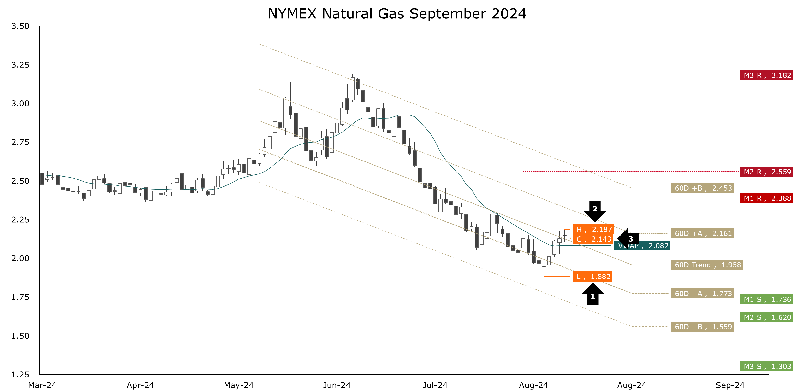
Henry hub ng futures
Natty In A Mini-Rally
Despite this season’s meager pace of gas refills to L48 storage, the contango (discount) on the end-of-summer Oct-24/Nov-24 spread on the NYMEX averaged -$0.459 per MMBtu over the past four weeks, 13% greater than that year’s average in the Oct-23/Nov-23 contango of -$0.404 per MMBtu. The backwardation on the end of next winter’s Mar-25/Apr-25 spread sank to a season-to-date low average of $0.1463 per MMBtu. Over the past four weeks, the spread averaged $0.169 per MMBtu, 42% lower than last year’s average in the Mar-24/Apr-24 premium of $0.294 per MMBtu. Strong contangos and weak backwardations are hallmarks of fundamentally bearish markets.
September NYMEX natural gas traced into a mini-rally over the past week. Since the contract turned prompt on July 30th, we saw a low of $1.882 per MMBtu (arrow 1) and a high of $2.187 per MMBtu. At the end of last week, the contract finished above the 60-day trend at $2.143 (arrow 3). Our two favorite technical indicators—Parabolic SAR and MACD—are bullish. Therefore, we will switch our seven-week-old bearish bias to bullish.
As far as the month ahead goes, based on the July 29th settlement at $1.965, the support levels are $1.736, $1.620, $1.303, and $0.733. The resistance levels are $2.388, $2.559, $3.182, and $5.658. The trend in the 60-day channel is $1.958, with an upper bound of $2.161 and $2.453. The lower bounds are $1.773 and $1.559.
Natural Gas Storage 64% Replenished, Injections Below Norm
As of August 02nd, L48 underground natural gas storage stands at 3.270 Tcf. This season's addition is 1.011 Tcf, significantly below the seasonal norm of 1.214 Tcf. At this time last year, the injection was 1.200 Tcf, 189 Bcf higher than this year’s pace. However, considering that last year's starting balance was much lower—1.830 Tcf compared to 2.259 Tcf—last year's injection is equivalent to a 381 Bcf increase on a proportional scale. We are 18 weeks into a refill season which typically lasts 32 weeks, as of last Thursday’s report, the market replenished 64% of last winter’s delivery.

