Slide 1
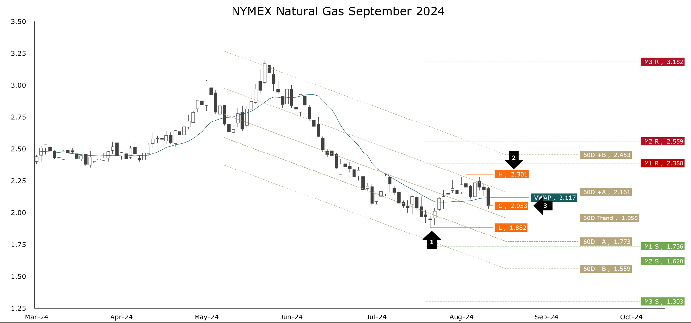
Henry hub ng futures
September Rally Stalls Amid Bearish Technical Indicators
September NYMEX natural gas futures kicked off August on a weak note but rallied through the first half of the month. The contract bottomed on August 5th at $1.882 per MMBtu (arrow 1) and rallied through August 15th to a $2.301 per MMBtu high (arrow 2). However, bullish momentum stalled around our first upper bound of the 60-day trend. The contract settled today at $2.053 per MMBtu (arrow 3).
Our two favorite technical indicators—Parabolic SAR and MACD—are bearish. Therefore, we will maintain a bearish bias.
As far as the remainder of the month ahead goes, our support levels for September gas are $1.736, $1.620, $1.303, and $0.733. The resistance levels are $2.388, $2.559, $3.182, and $5.658. Based on observed volatility, there is a 33% probability (odds 2:1) that the market will finish summer below $2.000 and a 0.5% probability (odds 200:1) that the market can rally and end summer above $3.000.
EIA reports low 35 Bcf injection.
One week after showing a delivery (withdrawal) of 6 Bcf of natural gas from L48 underground storage, yesterday the EIA reported an injection of 35 Bcf. As of August 16th, storage rose to 3.299 Tcf and this season’s addition climbed to 1.040 Tcf. By the middle of August, an injection of 1.348 Tcf is anticipated. At a minimum, an injection of at least 995 Bcf is expected. In other words, this season’s hitherto 1.040 Tcf injection is a mere 45 Bcf (4½%) away from the bare minimum.

