Slide 1
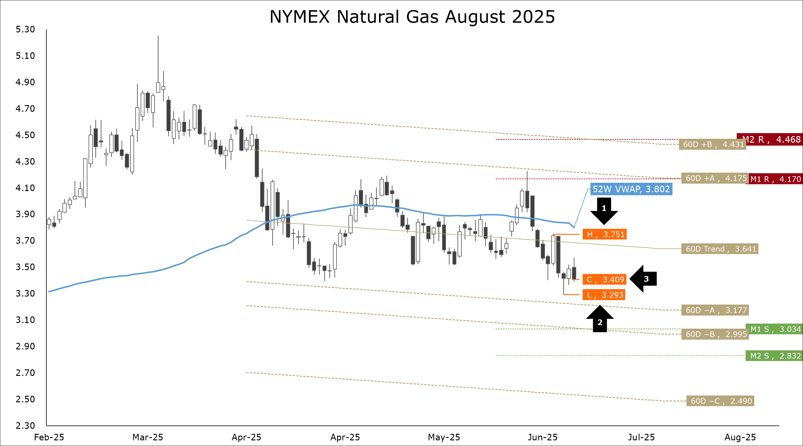
Henry hub ng futures
From Deficit to Surplus: Storage Swells, Futures Dip Below Key Averages
Lower 48 inventories of underground natural gas storage now sit at 2.953 Tcf. Since the start of refills, inventories flipped from a 213 Bcf deficit to our seasonally adjusted model, to a 110 Bcf surplus.
Season-to-date additions have reached a near record 1.255 Tcf, which is 218 Bcf above the historical range (95% confidence interval). Refills remain firmly on track to end the season above 3.800 Tcf.
Traders remain bearish. Last week, the contango on the cross-seasonal Oct-25/Nov-25 NYMEX Henry Hub spread averaged a 44-week high of -$0.386, and the backwardation on the end of next winter (Mar-25, Apr-25) averaged a four-month low of $0.272.
Despite a strong start to the peak cooling season, NYMEX futures ended last week lower at $3.409. The spot contract for August delivery finished 6.2% below the 20-day volume-weighted average price (VWAP), and 7.7% below the 52-week VWAP. Our preferred technical indicators (Parabolic SAR, MACD, and Stochastic), remain bearish.
Stay sharp. Hedge with confidence.
Storage Swells: EIA Reports Reasonable Storage Build
Last Thursday’s EIA report showed a reasonable injection of natural gas into L48 underground storage. For the week of June 27th, inventories rose by 55 Bcf. The typical injection for late June is 72 ± 19 Bcf.

