Slide 1
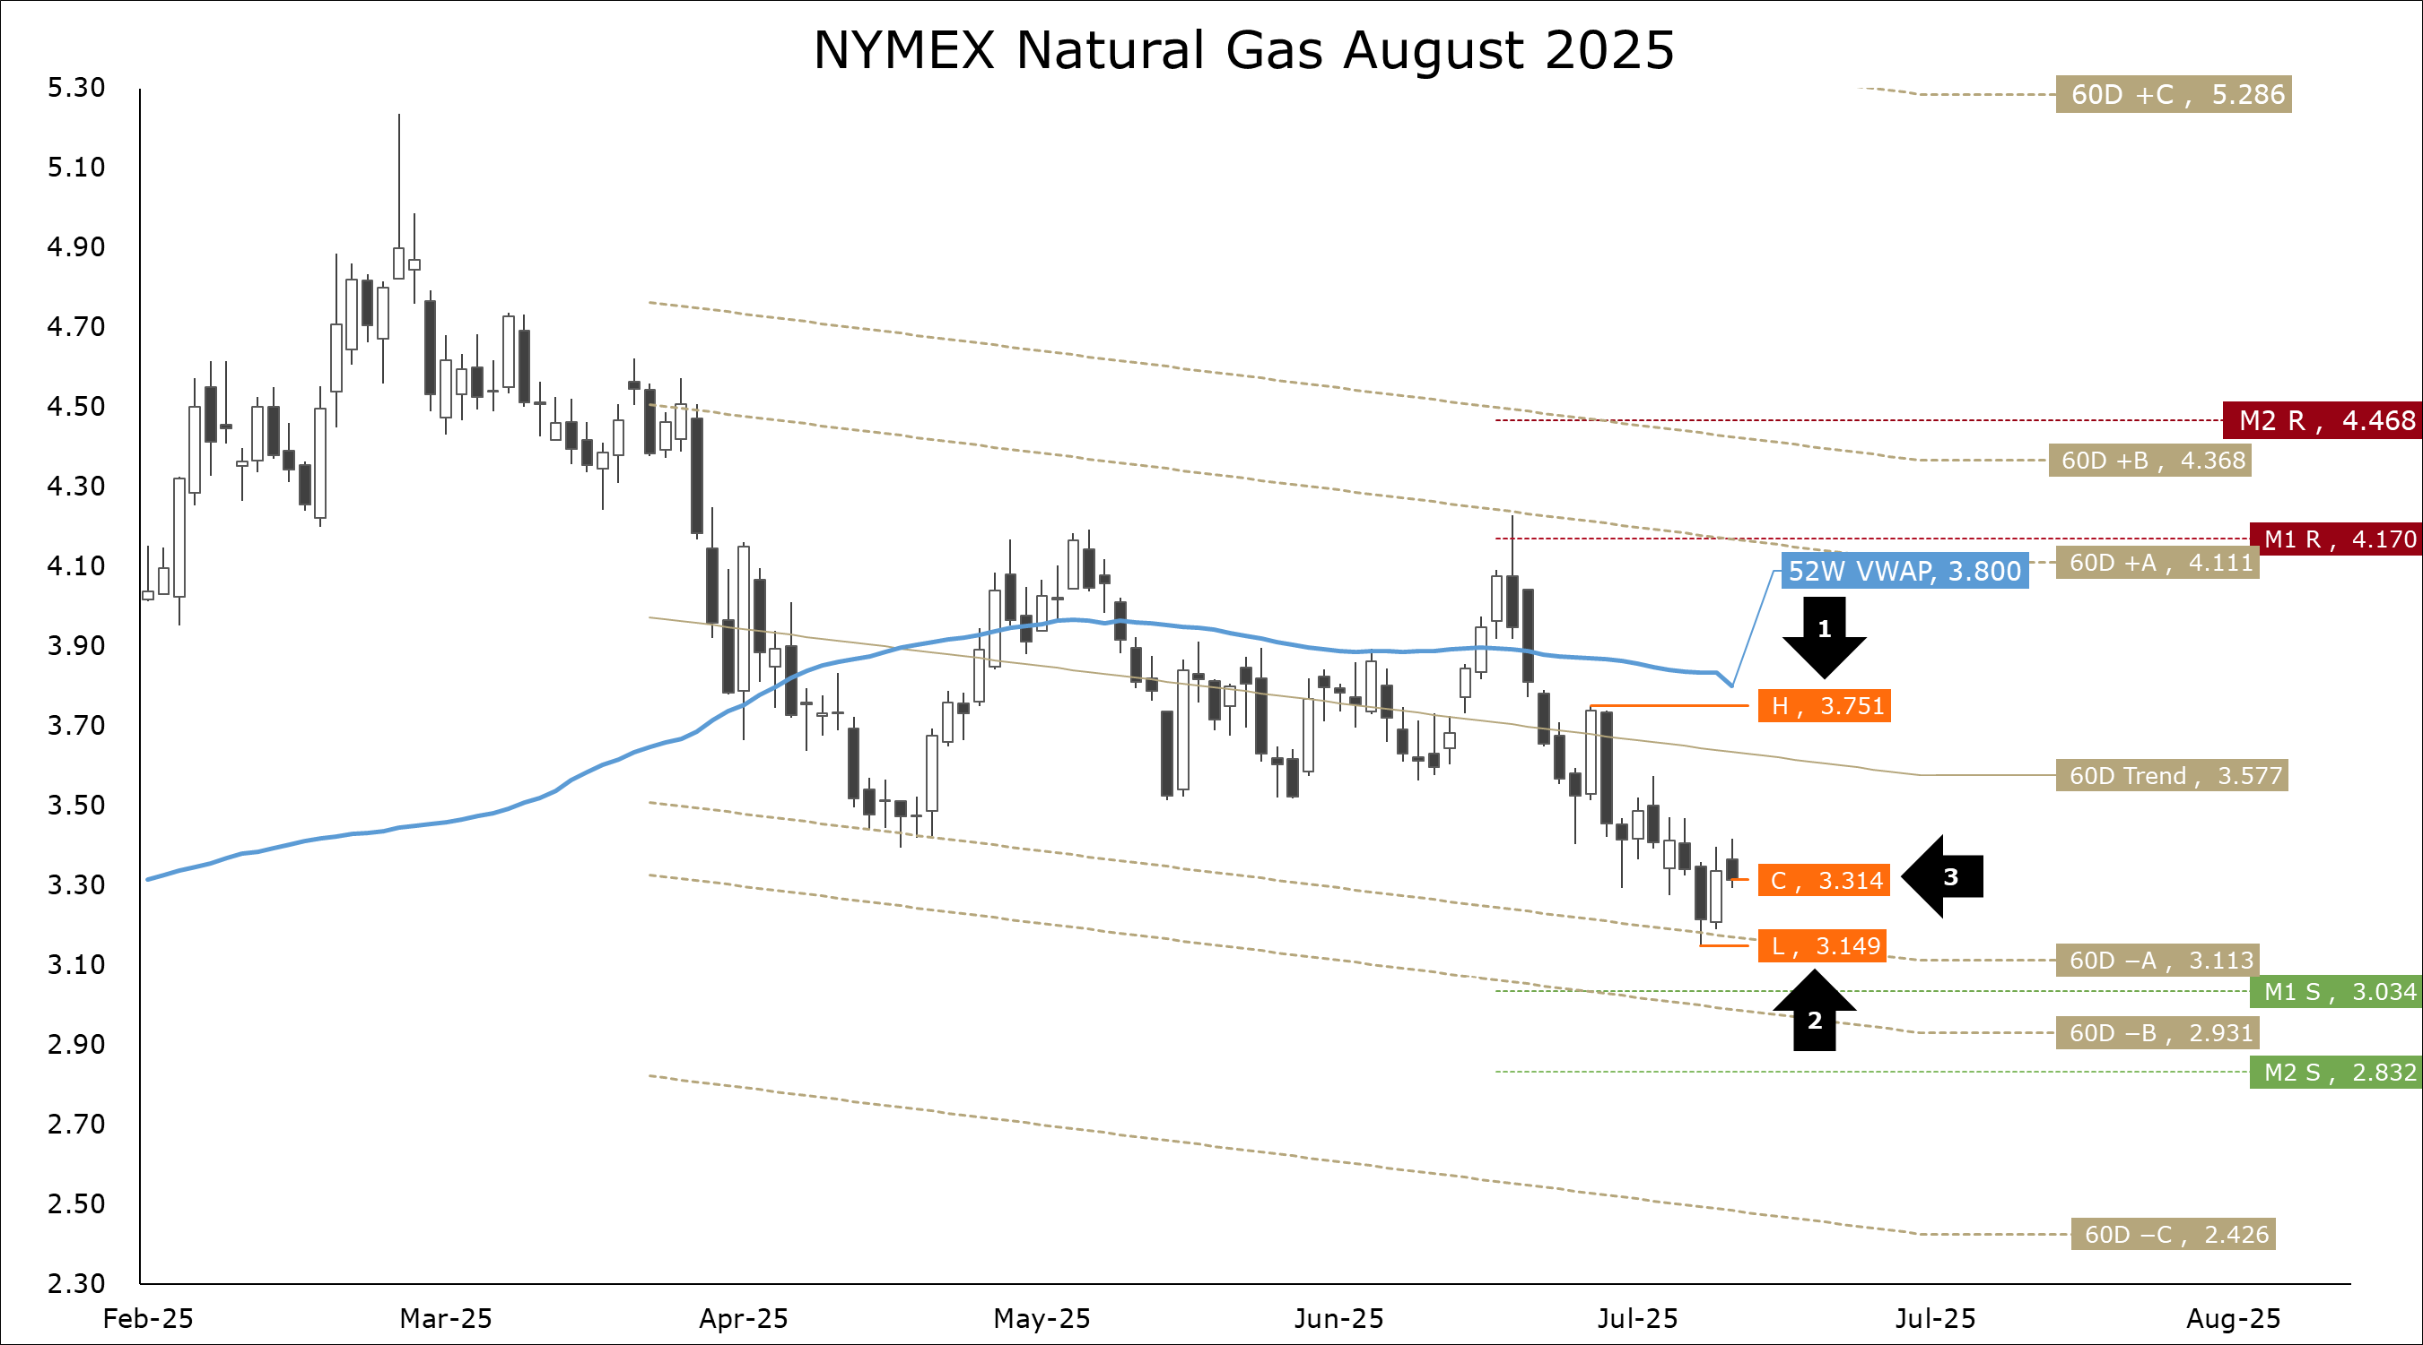
Henry hub ng futures
Natural Gas Bears Shrug Off Higher Cooling Demand
Yesterday’s EIA report showed a normal injection of 53 Bcf of natural gas into L48 underground storage. Inventories now sit at 3.006 Tcf. Since the start of refills, storage has flipped from a 213 Bcf deficit to our seasonally adjusted model, to a 105 Bcf surplus. Season-to-date additions are up to 1.308 Tcf, the second largest refill on record. We are not even at the halfway point of the season, and refills are on track to end the season above 3.900 Tcf.
As far as next Thursday’s report is concerned, cooling demand is higher this week. As of Wednesday, average natural gas demand for electricity generation is 1.7% or 97 GWhs per day higher, the equivalent of ≈0.58 Bcf/d of gas, 2.90 Bcf total. Based on our seasonal time series analysis, the typical injection for early July is 43 ± 11 Bcf. Our preliminary estimate is on the higher end of this range.
Traders are clearly unperturbed by this demand. After opening at the end of last winter at -$0.183, the contango on the cross-seasonal Oct-25/Nov-25 NYMEX Henry Hub spread finished yesterday at -$0.413. Based on the probabilistic model we wrote for this spread, the market is now trading well below the 25th percentile of expected returns.
At the same time, the spot market is just as weak. Yesterday, the August contract bounced back after posting back-to-back year-to-date lows. Our preferred technical indicators (Parabolic SAR, MACD, and Stochastic) remain bearish. As illustrated, we introduced our model for the third quarter. The market has been trading between our median expected return of $3.564 and the lower 50% envelope of $3.082.
Stay sharp. Hedge with confidence.
Storage Swells: EIA Reports Reasonable Storage Build
Last Thursday’s EIA report showed a reasonable injection of natural gas into L48 underground storage. For the week of June 27th, inventories rose by 55 Bcf. The typical injection for late June is 72 ± 19 Bcf.

